Slide 1
Password Rotation
A cautionary tale about
Security comms

Slide 2
Hi!

Slide 3
Hi, my name is...
Piero
What do I do?
IT Engineering @ GoCardless
Where can you find me?
@pmamberti
Notes:
GoCardless makes it easy to take recurring payments online.
Founded in 2011, we have quickly grown into one of the world’s leading Direct Debit providers processing over 5£Bn a year for over 30,000 businesses.

Slide 4
What is this about?

Slide 5
What is this about?
Password Rotation, what is it and does it matter?
How we wanted to implement it
How we failed at implementing it
What we learned

Slide 6
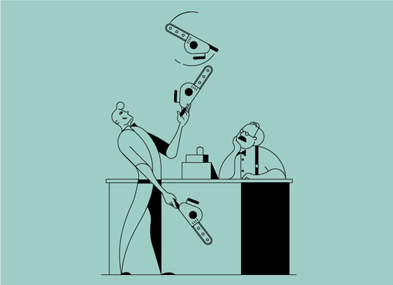
What is a Password Rotation Policy?

Slide 7
What is a Password Rotation Policy?
A Password Rotation Policy is a requirement for a password to be changed on a recurring basis.
This is based on the assumption that changing that password would prevent an attacker from using it past its expiration time.
Notes:
And this is…

Slide 8
This is stupid
Notes:
Well this is stupid. And I’ll tell you why:

Slide 9
This is stupid … and this is why
NIST thinks this is stupid:
https://pages.nist.gov/800-63-FAQ/
Q-B5: Is password expiration no longer recommended?
Q-B6: Are password composition rules no longer recommended?
The NCSC thinks this is stupid
https://www.ncsc.gov.uk/guidance/password-guidance-simplifying-your-approach
https://www.ncsc.gov.uk/articles/problems-forcing-regular-password-expiry
https://www.ncsc.gov.uk/blog-post/your-password-expiry-policy-may-have-reached-its-expiry-date
More people that think this is stupid:
https://www.ftc.gov/news-events/blogs/techftc/2016/03/time-rethink-mandatory-password-changes
http://people.scs.carleton.ca/~paulv/papers/expiration-authorcopy.pdf
https://www.troyhunt.com/passwords-evolved-authentication-guidance-for-the-modern-era/
Notes:
Actually, there is plenty of people that can tell you why that rotating password may not be a great idea. Here are some.
My 3 main arguments are:
Educating people in choosing better passwords makes empowers them in their life and your organisation as a byproduct. I think this is preferrable
Research exists that supports that when people are asked to rotate their password they will prefer a weaker password
Rotating a password will not help against a slightly more sophisticated attacker, social engineers get better and better and computational power is cheap these days.
So allow me to say, with dramatic license, that rotating password is stupid.

Slide 10
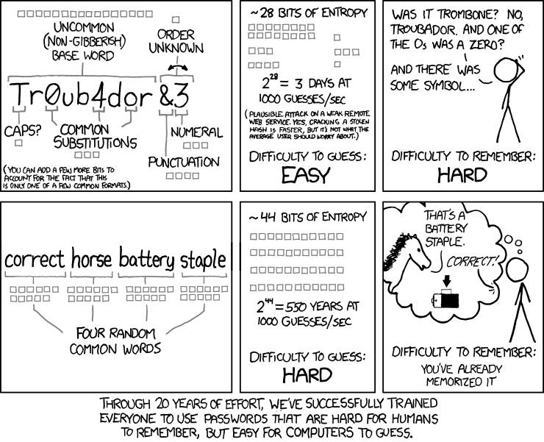
Or is it?

Slide 11
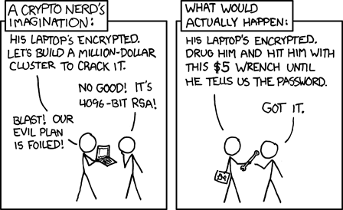
Sometimes it is not stupid
Humans:
Lazy
Predictable
Love sharing private stuff on social media
Panic when need to create a password
SCREW UP ENTROPY BADLY

Slide 12
What is it then? I am confused now...

Slide 13
What is it then?
Never rotating the passwords is a risk (and would be generally considered bad practice)
We should balance the risk mitigation against the amount of work and disruption that rotating a password will cause
Rotating password can mitigate against weak passwords, especially if you are not sure of the complexity
Most organisations rotate passwords to some degree of periodicity, complexity, and management rules.

Slide 14
Some People still think it’s great security

Slide 15
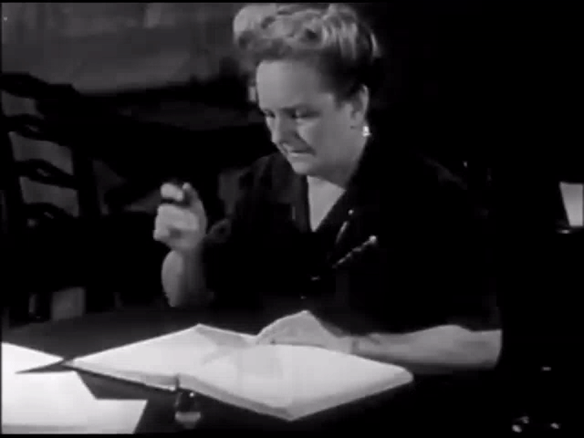
Who are these monsters?
Auditors
Auditors love asking this question and explain how if you are not rotating your passwords you’ll go to the naughty corner and you’ll not pass.
Remember: it may not be their fault and this may be the highlight of their day!

Slide 16
Let’s Recap

Slide 17
The story so far...
Humans are generally terrible with passwords and hate changing them (most humans also have some issue with authority...)
Rotating passwords does not guarantee great protection against determined attackers...
… but sometimes is required (and recommended)
Auditors love to tick the rotation box or be annoying about it
For all the above, we never introduced a Password Rotation Policy…
… and had no intention to do so anytime soon...

Slide 18
Then we got Audited

Slide 19
… oops
We challenged them but these things are binary: pass/not pass, no middle ground
A Password Rotation Policy becomes priority
We know that already enforce some of the requirements...
… but we need to expire the password and we don’t know how old they are.

Slide 20
We need a plan

Slide 21
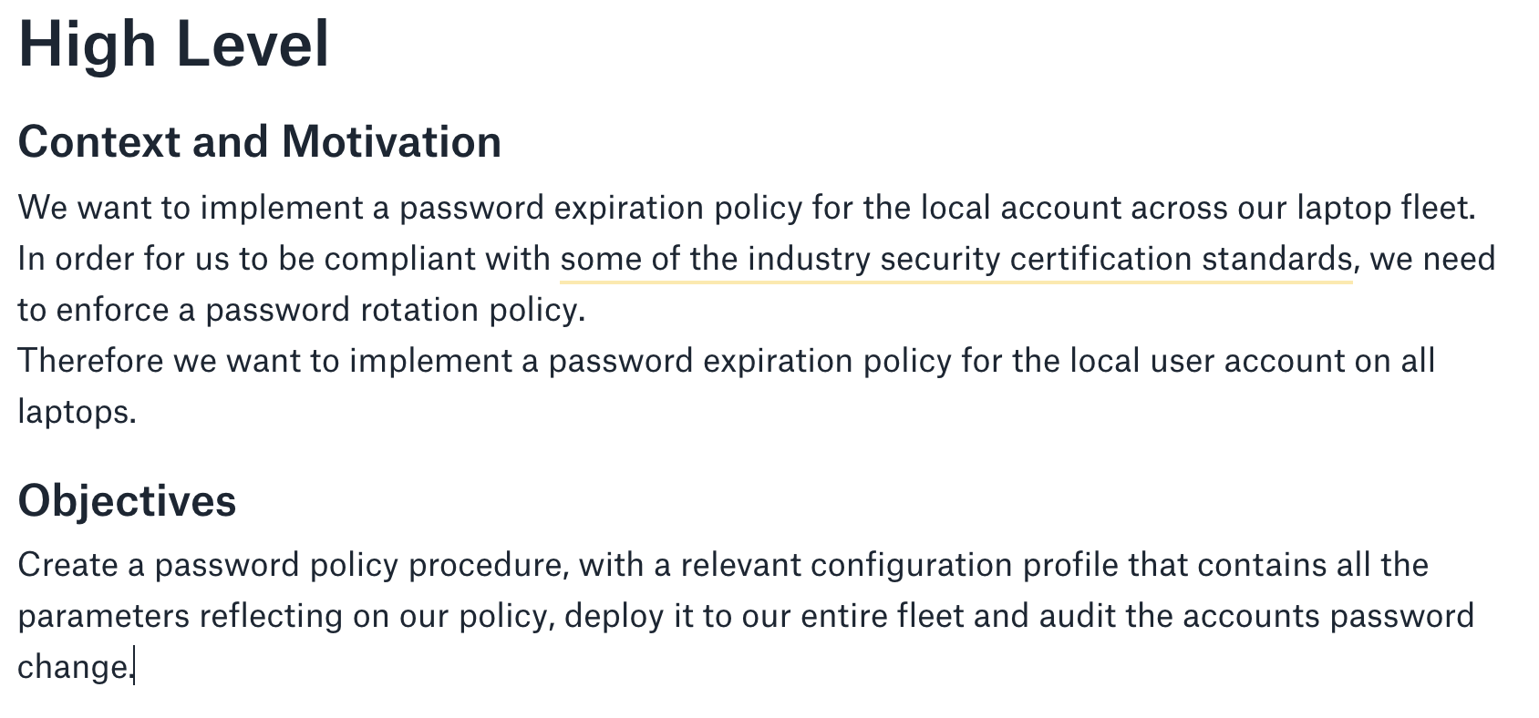

Slide 22
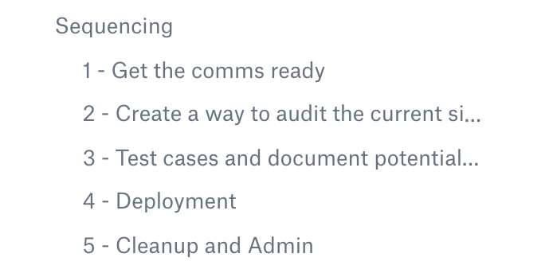

Slide 24
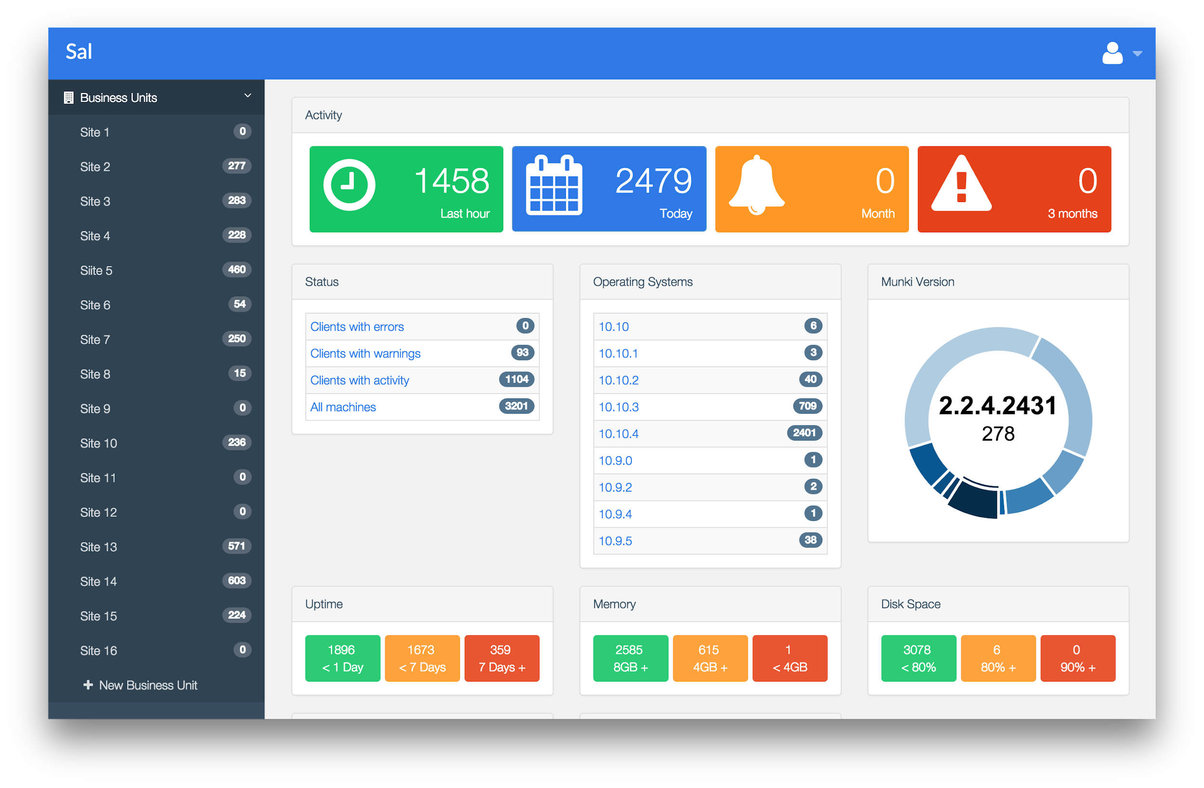
How are we doing it?

Slide 25
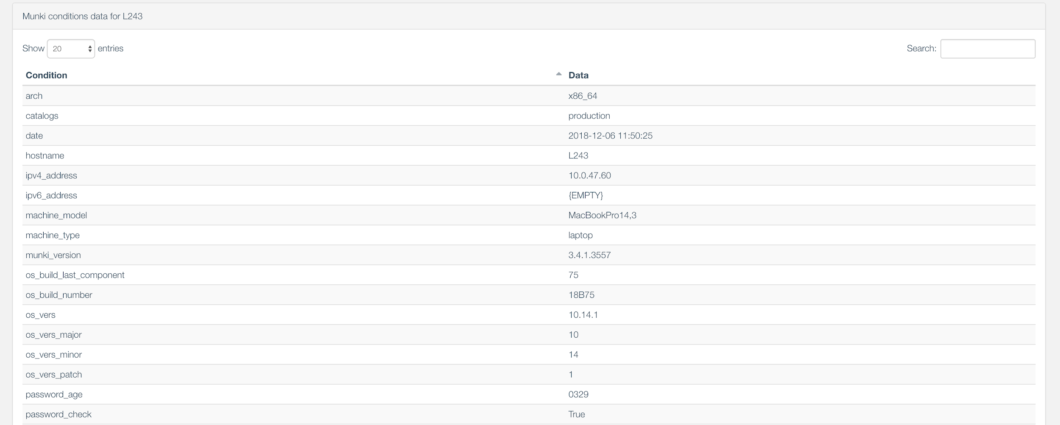
How are we doing it?

Slide 26
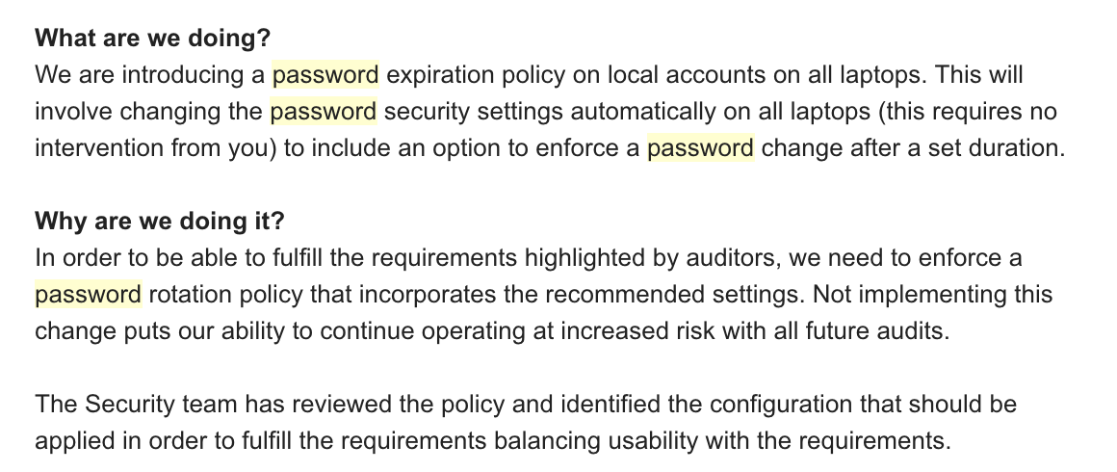
Ready for Kick Off!

Slide 27
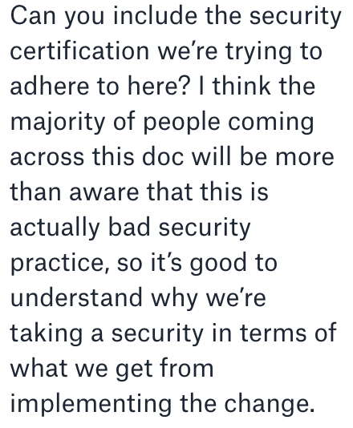

Slide 28
S#@t!

Slide 29
What went wrong?

Slide 31
What went wrong?
We failed at communicating the why
We did not provide a ‘longer term’ perspective to appropriately frame this upcoming changes
We underestimated our users

Slide 32
Lessons Learned
What would I do differently?

Slide 33
Lesson #1 - Start MORE with Why
The audit was not the problem, it only exposed it: We can’t audit our password complexity, therefore we need to rotate them
We know from empirical data that users are using passwords that are not very secure
Ticking the box is important, but our user’s security is way more important and never rotating is bad practice
Ensure this why is clearly communicated to stakeholders

Slide 34
Lesson #2 - Provide a longer horizon
We don’t want to rotate often but we need to improve in order to do so
We will be working to increase the rotation period as much as possible but it cannot happen immediately
We need a temporary rotation policy now
We will revise and update it as our improved tools increase our confidence in a stronger password baseline

Slide 35
Lesson #3 - Give users credit
We are too close to the technology and sometimes become detached with our users’ reality
We are a tech company and 45% of us works in an engineering function
Users are a lot more security aware than we expect them to be
Tailor comms to a user base that is aware of best practises and tech savvy

Slide 36
Lesson #4 - SAL search and python string comparison
Sal compares strings, which is why we report the age in days as ‘0100’ instead of ‘100’
String comparison is annoying when working with numbers as it will do things like this (😓): >>> a = '90' >>> b = '100' >>> a > b True
zfill will help you to add 0s to the left of your number (zeropadding) to ensure consistent comparison results

Slide 37
That’s all I’ve got

Slide 38
Question Time!

Slide 39
We are hiring! If you are interested, let’s talk!

Slide 40
Thank You

